Slide 1



Performance testing meets
The Cloud

Slide 2

What is Performance Testing?

Slide 3
Wiki:
a testing practice performed to determine how a system performs
in terms of responsiveness and stability
under a particular workload
https://en.wikipedia.org/wiki/Software_performance_testing

Slide 4
Server
(system under load)
User 1
User 3
…
User n
User 2

Slide 5
Performance testing: best practices
Users are different - i.e. sending unique (not hardcoded) requests
Users are geographically distributed – so should be the test
Performance testing should be done regularly

Slide 6
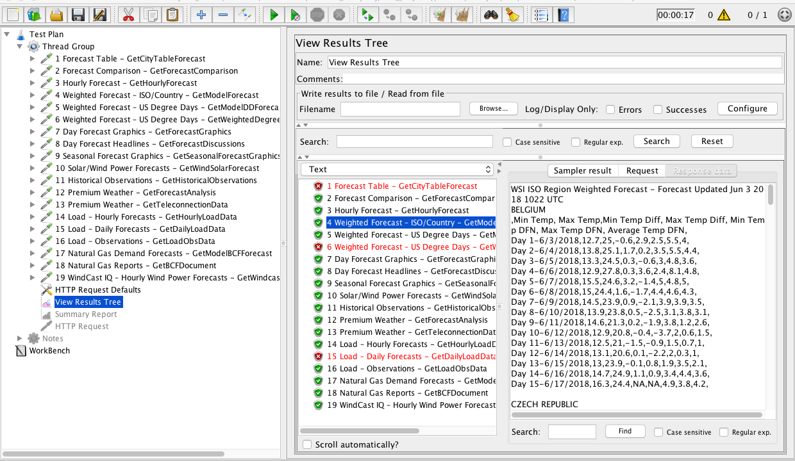
Emulate real users - JMeter

Slide 7
JMeter Pros:
Easy to start with
Collects performance metrics and generates pretty reports
Scripts to generate unique requests on the go (Groovy, BeanShell, etc.)
Active community and plenty of extensions for non-trivial tasks
Allows distributed testing - important

Slide 8
However – when JMeter run “single handed”:
No geographical diversity – all requests coming from the same region (throughput limitation)
Limited abilities of a single instance to generate load (memory issues)
Thus:
running tests with a single JMeter instance is not a proper performance testing

Slide 9
Solution:
Set up several JMeter instances in different areas (Amazon Web Services might help)
Run performance tests in distributed mode

Slide 10
Server (system under load)
…
…
Requests
Responses
AWS EC2
AWS EC2
…
AWS EC2
JMeter
Slave 1
JMeter
Slave 2
JMeter
Slave n
Performance Stats
RMI Instructions
AWS EC2
Load Scenario
Performance Report
JMeter Master

Slide 11
Setting up an AWS EC2 instance with JMeter:
Set up Virtual Private Cloud;
Set up Subnet;
Set up Internet Gateway;
Set up Route Table and Association;
Set up Security Group;
Add Key Pair;
Start Instance with public IP;
Install and configure JMeter (open ports, get IP).
Do that as many times as many instances you want.

Slide 12
Run distributed JMeter test in console:
jmeter -n -t load_script_name.jmx
-R 54.172.38.36,…,18.144.50.21 -l report_name.jtl

Slide 13
JMeter Dockerized:
Ubuntu + Java
Ubuntu + Java
JMeter Master
(Manages Slaves):
- Port 60000 exposed
JMeter Slave
(Generates Load):
- Port 1099 exposed
- Port 50000 exposed

Slide 14
Dockerized JMeter on AWS:
AWS EC2:
Network, Docker
AWS EC2:
Network, Docker
Ubuntu + Java
Ubuntu + Java
JMeter Master
(Manages Slaves):
- Port 60000 exposed
JMeter Slave
(Generates Load):
- Ports 1099, 50000 exposed

Slide 15
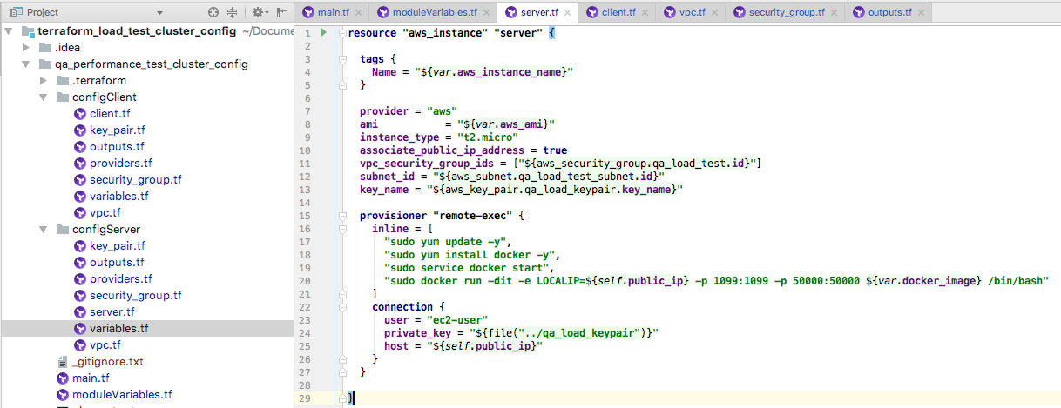
Take automation one step further?
Configure the AWS infrastructure automatically with Terraform:

Slide 16
Before you run the whole thing,
make sure to have:
Valid AWS credentials in ~/.aws/credentials file
Git, Terraform installed

Slide 17
In the command line,
clone the project:
git clone https://github.com/artie-sh/performance_testing_terraform_aws_docker_jmeter.git
enter the project folder:
cd performance_testing_terraform_aws_docker_jmeter

Slide 18
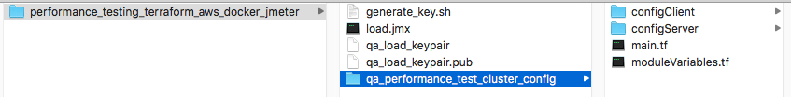
generate ssh keys:
./generate_key.sh

Slide 19
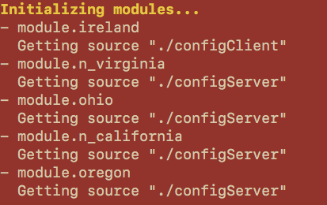
enter the terraform folder:
cd qa_performance_test_cluster_config
initialize modules:
terraform init

Slide 20
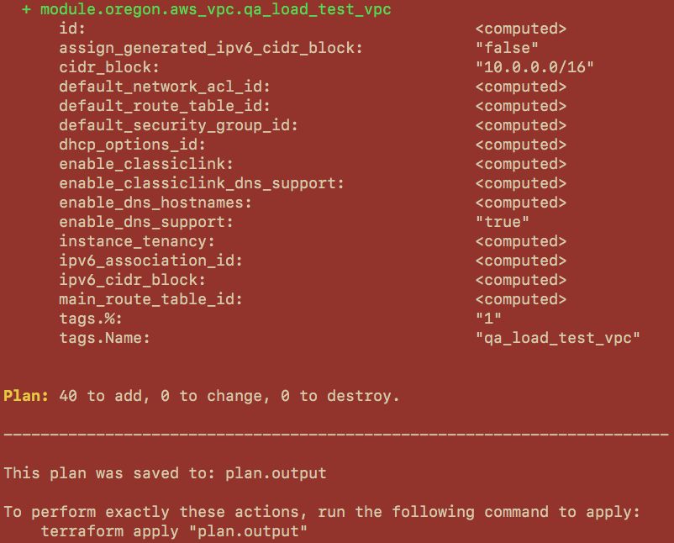
plan the output:
terraform plan -out plan.output

Slide 21
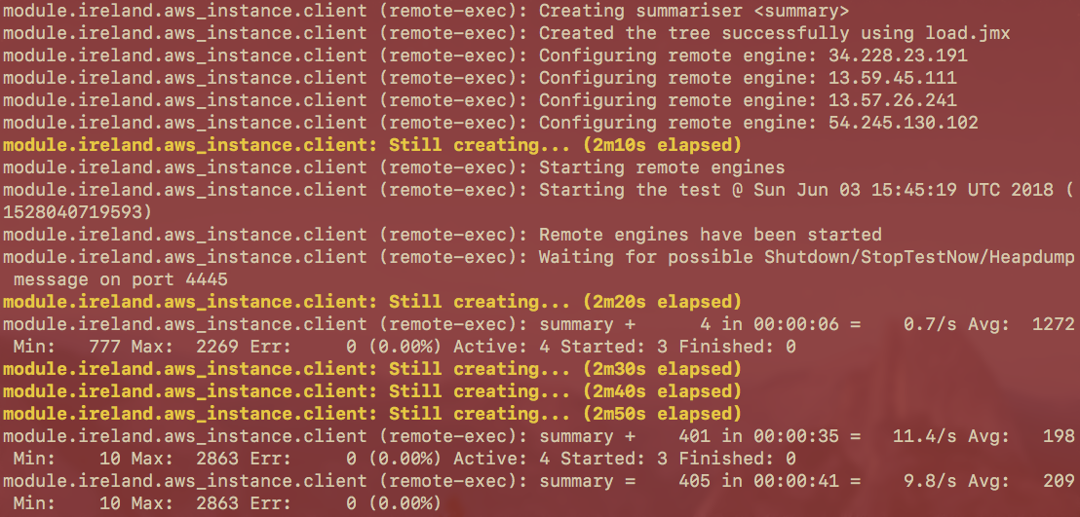
apply the plan:
terraform apply plan.output

Slide 22
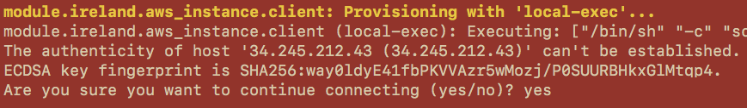
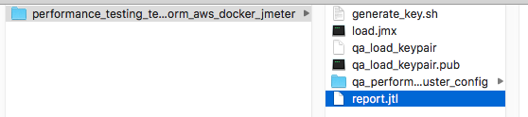
agree to accept the report file:
yes + enter
see report.jtl

Slide 23
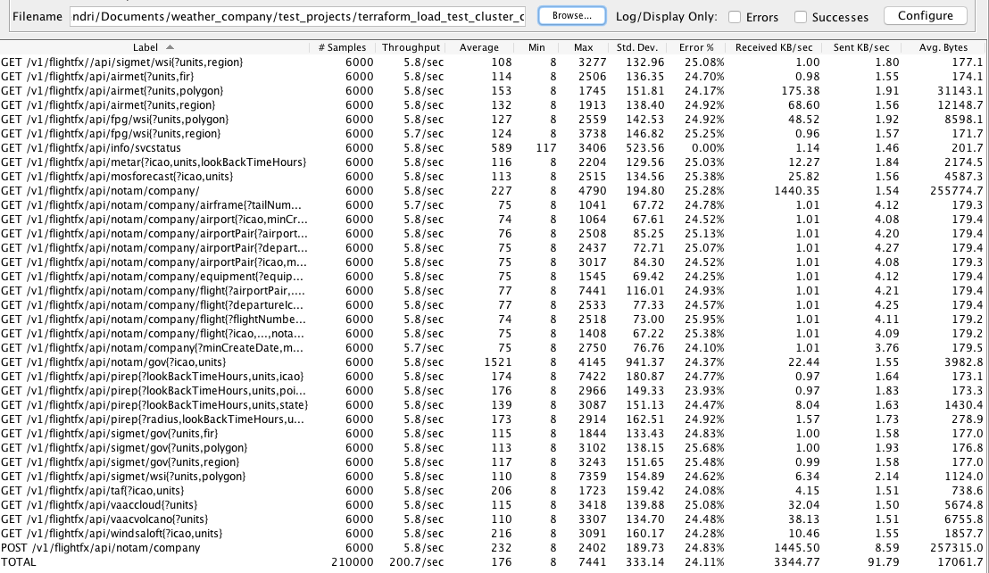
open report in JMeter

Slide 24
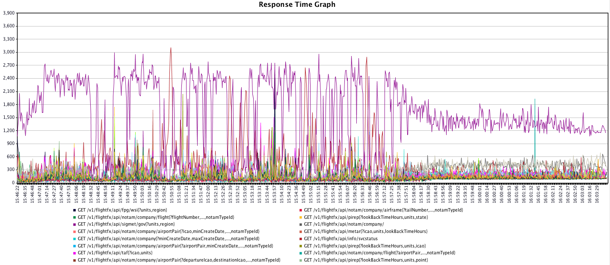
open report in JMeter

Slide 25
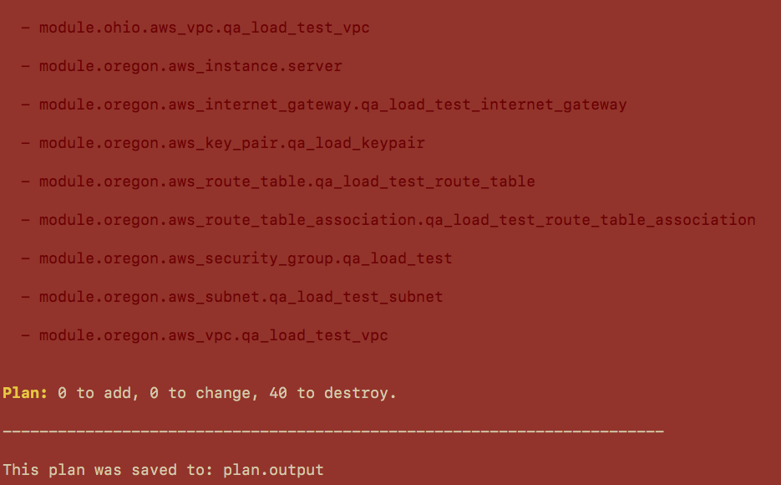
destroy infrastructure after test is done:
terraform plan -destroy -out plan.output

Slide 26
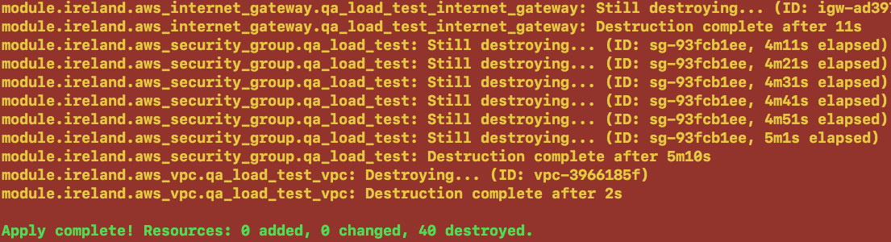
apply destroy plan:
terraform apply plan.output

Slide 27

Special thanks to
Yuriy Maftiyak

Slide 28
See you on our next meeting in September!
06 / 09 / 2018

